Slide 1
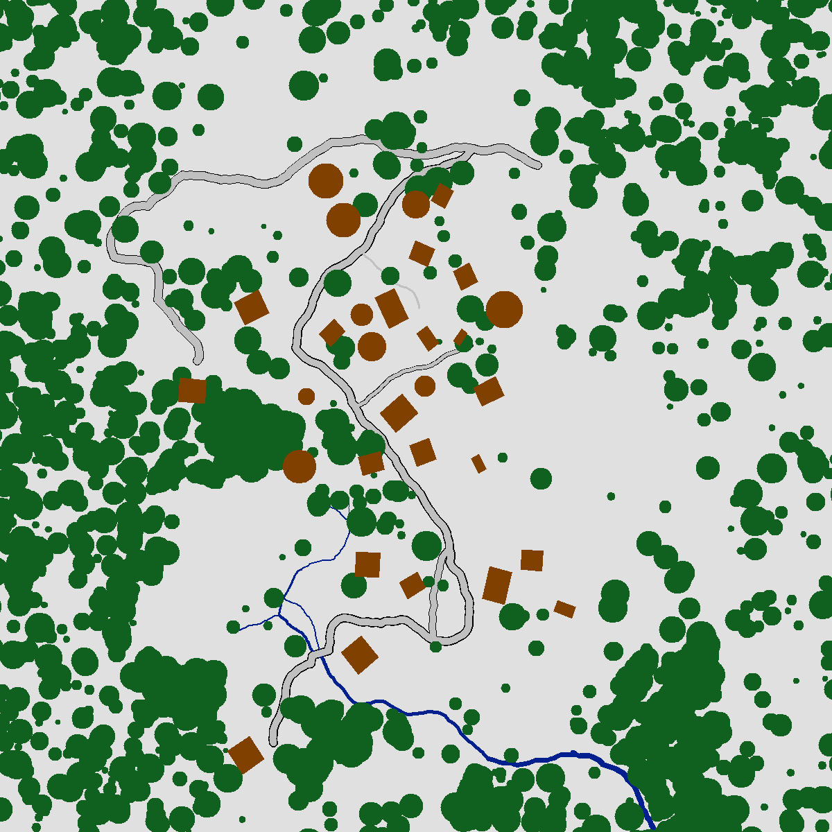
Reinhart’s Heart
Granary
Town hall
Bailiff’s House
Reeve’s House
Inn
Warehouse
Blacksmith’s Shop
Barrack Complex
Adavald’s Cottage
Old Carpenter’s Cottage

